Slide 1
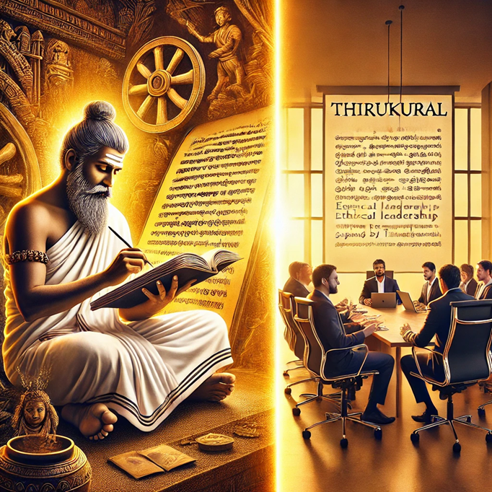

Relevance of Thirukural in Modern Management
30th January, 2025

Slide 2


Slide 3


Slide 4


Slide 5


Slide 6
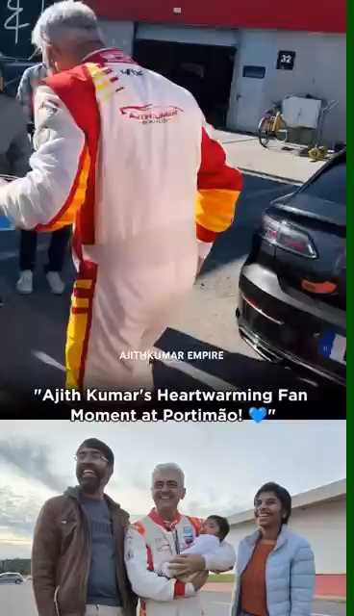

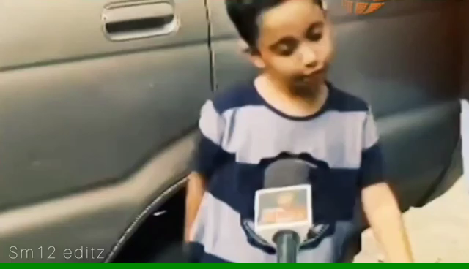
Humility
பணிவு
மிகைபேர் மிகுதியான் திண்மை எய்தும்அகழ்வாரை நீர பிற.
"Excessive pride is like digging a well in a dry place; it leads nowhere."

Slide 7

Management
Getting things done through people
Making things happen
மக்கள் மூலம் காரியங்களைச் செய்வது
பணிகளை முடித்தல்

Slide 8
Management Concepts in Thirukkural
Leadership and Vision
Ethics and Integrity
Decision-Making
Time Management
Conflict Resolution
Assignment of jobs based on merit
தலைமைத்துவம் மற்றும் தெளிவான பார்வை
நெறிமுறைகள் மற்றும் நேர்மை
முடிவெடுத்தல்
நேர மேலாண்மை
மோதல் தீர்வு
தகுதியின் அடிப்படையில் பணி ஒதுக்கீடு

Slide 9
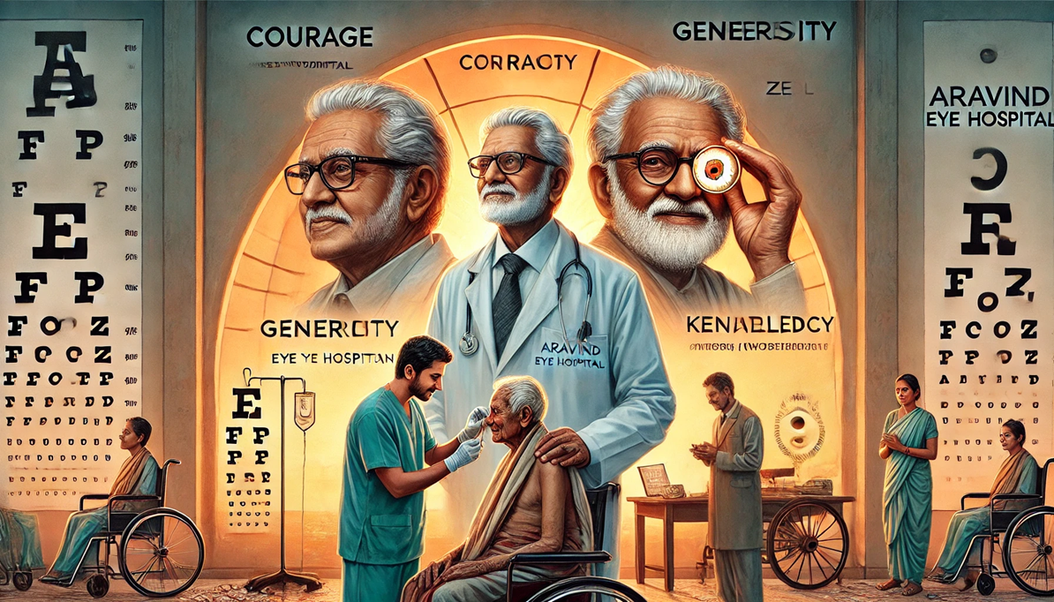
Leadership and Vision
Courage, generosity, knowledge /wisdom, motivation (Zeal) are the four essential elements of a successful leader
அஞ்சாமை ஈகை அறிவூக்கம் இந்நான்கும்
எஞ்சாமை வேந்தற் கியல்பு.

Slide 10
Leadership and Vision
1. Courage
Visionary Boldness: Dr. Govindappa Venkataswamy (fondly known as Dr. V) established Aravind Eye Hospital with an ambitious goal: to eliminate needless blindness not just in India, but globally. Despite starting in a small rented premise and with limited resources, his unwavering belief in affordable, high-quality eye care exemplified extraordinary courage.
2. Generosity
Compassion in Action: From its inception, Aravind Eye Hospital’s guiding principle has been to provide free or heavily subsidized services to those who cannot afford treatment. This approach, inspired by Dr. V’s personal philosophy of selfless service, has restored sight to millions of underprivileged individuals.
3. Knowledge (Wisdom)
*Innovative Operational Model:* Dr. V combined medical expertise with ingenious management practices, creating an efficient cross-subsidization model where revenues from paying patients support the treatment of the poor. He also emphasized rigorous training of medical staff, standardized procedures, and high-volume surgeries without compromising quality.
4. Motivation (Zeal)
*Leading by Example:* Despite personal health challenges (he suffered from rheumatoid arthritis that affected his hands), Dr. V’s relentless drive inspired colleagues to commit themselves fully to Aravind’s vision. His humility and genuine concern for every patient fostered a culture of empathy and excellence. This unwavering zeal—embodied in daily practice—continues to motivate generations of doctors, nurses, and support staff to carry forward his mission of eradicating needless blindness.

Slide 11
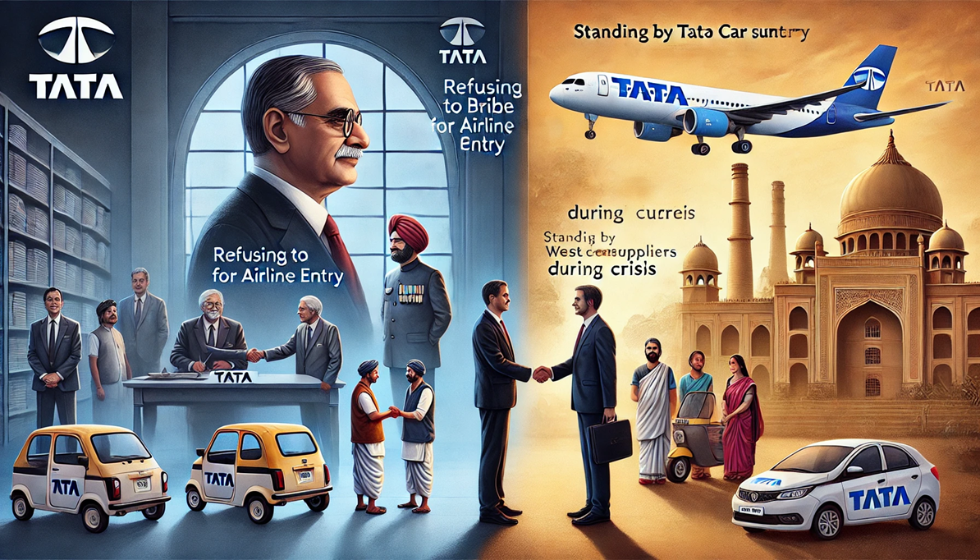
Ethics and Integrity
Even if it promises great benefit, if it deviates from fairness, it should be discarded at once.
நன்றே தரினும் நடுவிகந்தாம் ஆக்கத்தை
அன்றே யொழிய விடல்.

Slide 12
Ethics and Integrity
Case: Refusing to Bribe for Airline Entry
In the 1990s, Tata Group attempted to enter the airline industry with Tata Airlines in collaboration with Singapore Airlines. However, the proposal was blocked due to political interference, and a minister allegedly demanded a bribe to approve the deal.
Case: Standing by Nano Car Suppliers During Crisis
In 2008, Tata Motors introduced the Tata Nano, the world’s cheapest car, to provide affordable transportation for the poor. However, political protests forced Tata to relocate the entire factory from West Bengal to Gujarat at great cost.
Tata’s Ethical Stand:
  Instead of abandoning suppliers who had set up businesses near the original factory, Tata Group compensated them and helped them relocate.
  This rare act of business ethics ensured no one suffered unfairly due to political turmoil.

Slide 13
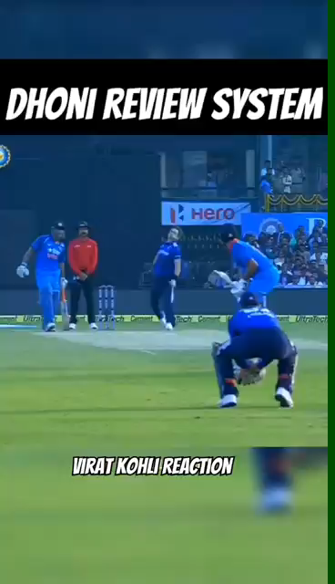

Decision Making
A successful person first analyses, plans, and then executes the task efficiently.
செய்வினை செய்வான் செயன்முறை அவ்வினை
உள்ளறிவான் உள்ளம் கொளல்.

Slide 14
Decision Making
In 2005, Videocon acquired Thomson’s colour picture tube (CPT) manufacturing business. This deal—valued at approximately 240 million euros—included Thomson’s CRT plants in several locations worldwide, including a major picture tube factory in Poland (Europe), as well as facilities in Mexico and China.
Rapid Market Erosion: The widespread adoption of LCD/LED technology compressed CRT demand more quickly than anticipated, leading to underutilized factories.

Slide 15
Time Management
Acting too early or too late can lead to failure, but those who time their actions wisely will achieve success.
காலம் கருதி இருப்பர் கலங்காது
ஞாலம் கருது பவர்.

Slide 16
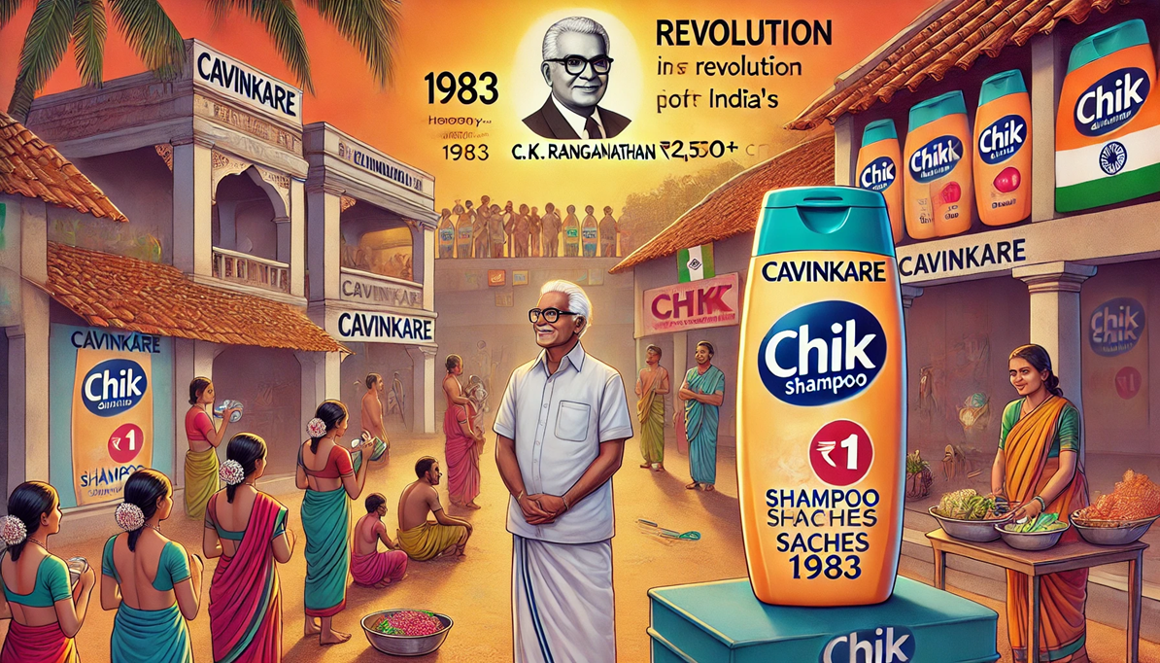
Time Management

Slide 17
Conflict resolution
The best punishment for those who harm you is to shame them by doing good in return
இன்னாசெய் தாரை ஒறுத்தல் அவர்நாண
நன்னயஞ் செய்து விடல்.

Slide 18
Conflict resolution
Dhirubhai Ambani, the founder of Reliance Industries, epitomized the idea that the best punishment for those who harm you is to rise above it by doing good in return.
Early in his career, Ambani faced fierce competition and sabotage from larger, established businesses in the textile industry.
Instead of retaliating or engaging in negativity, he focused on innovation, offering better products at affordable prices. His groundbreaking decision to take Reliance public, allowing average citizens to become stakeholders, turned the tide, ultimately forcing his competitors to acknowledge his success.
Ambani’s story shows that success, driven by integrity and positive action, can shame detractors and silence those who seek to harm you.

Slide 19
Assignment of jobs based on merit
Assured this man will do this task this way,
Leave it to him.
இதனை இதனால் இவன்முடிக்கும் என்றாய்ந்து
அதனை அவன்கண் விடல்.

Slide 20
Assignment of jobs based on merit
Unconventional Hiring Story: Sridhar Vembu & Zoho's Unique Talent Strategy
Founder’s Vision: Sridhar Vembu, the founder and CEO of Zoho, believes in hiring based on potential rather than credentials.
Rural Talent Focus: Instead of prioritizing elite degrees or corporate experience, Zoho identifies motivated young individuals from rural areas and small towns.
Beyond Traditional Recruitment:
  Does not rely on conventional hiring methods like campus placements from top universities.
  Often hires high school graduates with raw talent and curiosity.
Zoho Schools of Learning:
  An in-house training program designed to upskill fresh talent.
  Provides intensive hands-on education in software development, problem-solving, and leadership.
Skill-Based Development:
  Focuses on mentorship and real-world learning rather than textbook knowledge.
  Grooming employees internally instead of depending on external hiring.

Slide 21
What can you do?
நீங்கள் என்ன செய்ய முடியும்?
You can’t change the whole world, and you certainly can’t change other people, but you do have the ability to change yourself.
நீங்கள் முழு உலகையும் மாற்ற முடியாது, மற்றவர்களை நிச்சயமாக மாற்ற முடியாது, ஆனால் உங்களை மாற்றும் திறன் உங்களுக்கு உள்ளது.

Slide 22


